Slide 1
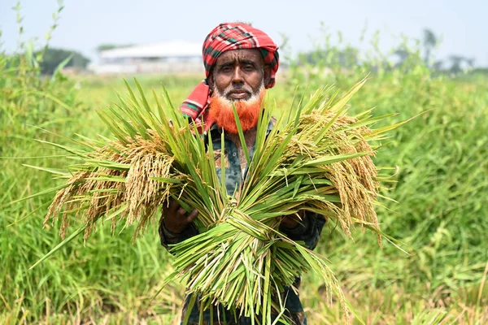
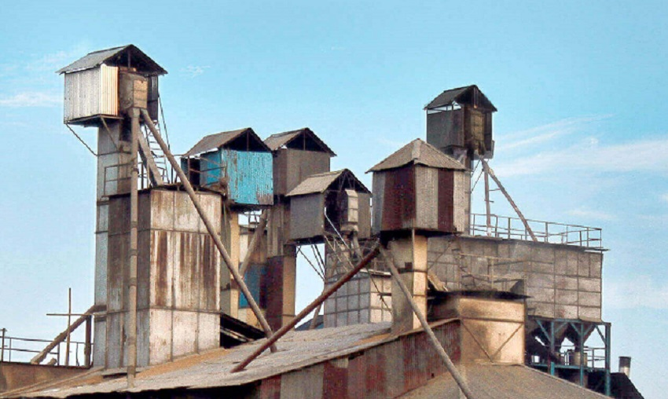

Auto Rice Mill Management System
Presented BY
Shah Sultan 379
Abdullah Nazmus-Sakib 383
Khaled Mahmud Jon 391
Tawhidul Islam 395
Notes:
Auto Rice Mill Management System

Slide 2

Brief Overview of the Proposed Project
The Auto Rice Mill Management System makes the entire rice production process easier by bringing farmers, mill managers, and customers together on one platform. It simplifies selling paddy, managing milling, and buying rice, with real-time updates and smooth communication, making the journey from farm to table faster and hassle-free for everyone involved.
Notes:
Today we are going to discuss design a system called Auto Rice Mill Management System & what is the main purpose of this system.
In Auto Rice mill Management system there are three actor
Farmer-
Customer
Mill Manager
The Auto Rice Mill Management system is a digital solution that help to manage entire milling process buying paddy from farmers to process rice to selling to customers
In traditional rice mills, there are lot of things like searching paddy to customer houses or market, milling, keeping inventory and selling rice manually are often done. It is slow, messy and inefficient.
So our system handling everything digitally, we can save time, reduces errors and help the business run smoothly and connect everyone in one platform that help our life simpler for everyone involved it and better than manual way.

Slide 3
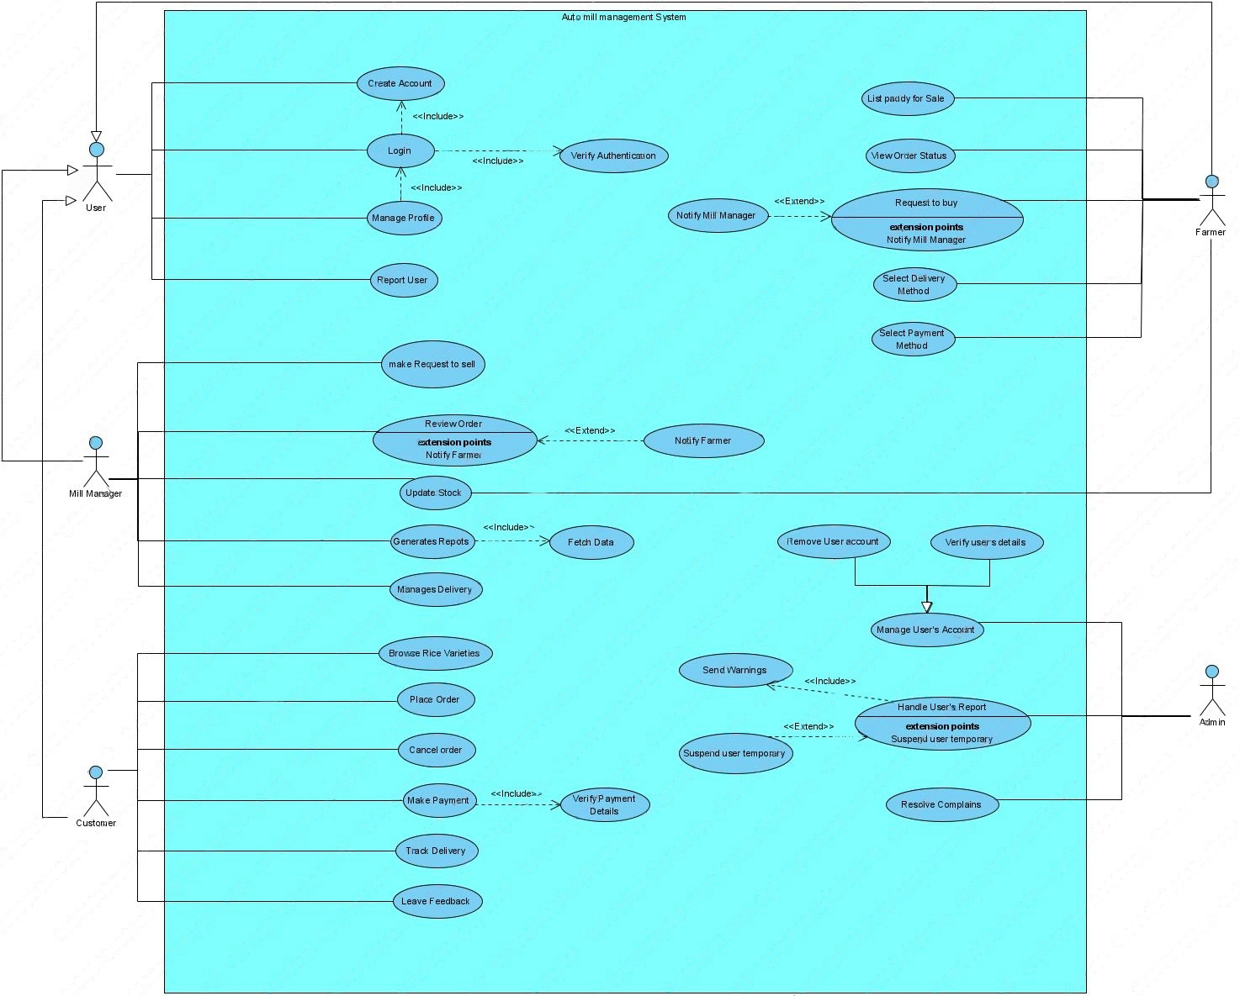
Use Case Diagram
Use case diagram describe the functional requirement of the system. Transform a functional requirement into class and method. Use case diagram shows the interaction between actor and their requirement.
Notes:
Before Moving use case diagram, we have to know,
When design a system there are two types of requirement one is functional requirement and another is non functional requirement. Use case diagram describe the functional requirement of the system. Transform a functional requirement into class and method. Use case diagram shows the interaction between actor and their requirement. In our system four actor, Here the user interaction.

Slide 4

User Story 1
Buy Paddy
Acceptance Criteria:
Checking request and making request
view a list of farmers selling paddy.
Check available quantity, quality/type, and price per unit.
Accept request
Delivery
Quality check and payment
As a: Mill Managers
I want to: buy paddy directly from farmers
So that: I can keep enough stock and make sure there’s always quality paddy available for milling.

Slide 5

User Story 2
Sell Paddy
Acceptance Criteria:
Create a sales list for paddy.
Set type, quality, quantity, and price per unit of paddy
Making or accepting request.
Negotiate for price, delivery and payment method
Delivery
Received payment
As a: Farmer
I want to: sell my paddy directly to mill managers,
So that: I can easily find buyers and get fair prices for my crops.

Slide 6
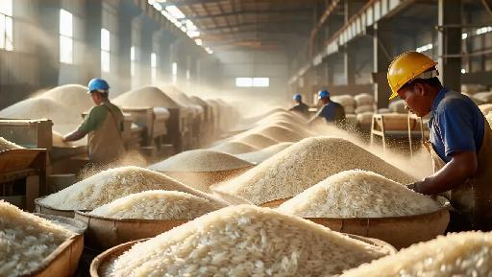
Use Case Name : Stock Update
Extended Use Case 1
Actor: Mill Manager
Description:
This use case describes the process by which a mill manager updates the stock inventory after receiving paddy from farmers.
Receive Paddy Delivery
Confirm Quality
Access Stock Update Interface
Update Stock
Confirmation Notification
Stock Update

Slide 7

Use Case Name : Leave Feedback
Extended Use Case 2
Actor: Customers
Description:
This use case describes the process by which a customer leaves feedback after receiving their rice order.
Access Order History
Select Order
Navigate to Feedback Section
Fill Out Feedback Form:
Submit Feedback
Confirmation Notification
Leave Feedback

Slide 8
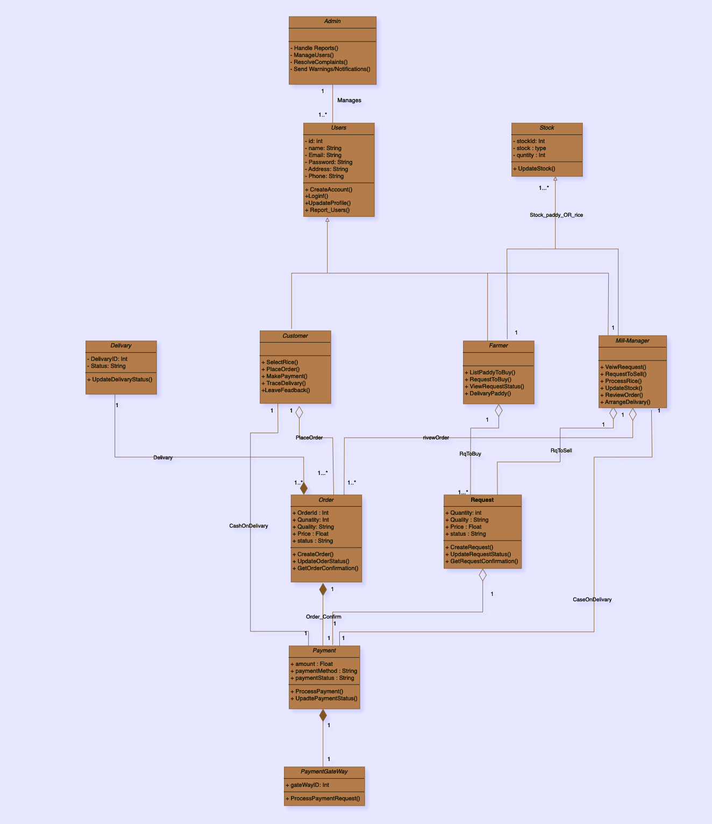
Class
Diagram
A class diagram is a type of static structure diagram that represents the classes, their attributes, operations (or methods), and the relationships among the classes in a system. It provides a visual representation of the system’s structure and serves as a blueprint for building the system.
Notes:
Class Diagram in Object-Oriented Analysis and Design (OOAD)
Definition:
A class diagram is a type of static structure diagram that represents the classes, their attributes, operations (or methods), and the relationships among the classes in a system. It provides a visual representation of the system’s structure and serves as a blueprint for building the system.
Components of a Class Diagram:
1. Classes: Represented as rectangles divided into three compartments:
• Top compartment: Name of the class.
• Middle compartment: Attributes (properties or fields) of the class.
• Bottom compartment: Methods (functions or operations) of the class.
2. Attributes: Characteristics or properties of a class that define its state.
3. Methods: Functions or operations that define the behavior of a class.
4. Relationships: Show how classes interact with each other, including:
• Association: A relationship where one class uses or interacts with another.
• Aggregation: A special form of association that represents a “whole-part” relationship.
• Composition: A stronger form of aggregation where the lifetime of the part is tied to the whole.
• Inheritance: A mechanism to create a new class based on an existing class, inheriting its attributes and methods.
Why Use Class Diagrams?
1. Visual Representation: Class diagrams provide a clear and organized view of the system’s structure, making it easier to understand and communicate the design.
2. Blueprint for Development: They serve as a blueprint for developers, guiding the implementation of classes and their interactions in the code.
3. Identify Relationships: Class diagrams help identify and define the relationships between different classes, which is crucial for understanding the overall architecture of the system.
4. Facilitate Maintenance: A well-structured class diagram can simplify system maintenance and updates by providing an overview of how classes are related and how changes in one class might affect others.
5. Support Object-Oriented Principles: They embody object-oriented design principles like encapsulation, inheritance, and polymorphism, helping ensure that the system is built on solid design foundations.
6. Documentation: Class diagrams serve as part of the documentation for the system, providing insight into its structure and facilitating better onboarding for new developers.
Example of a Class Diagram
Here’s a simple example of a class diagram for an Online Rice Mill Management System:
+-------------------+
| Farmer |
+-------------------+
| - name |
| - contactInfo |
| - farmLocation |
+-------------------+
| + listPaddy() |
| + receivePayment() |
+-------------------+
|
| 1
| *
|
+-------------------+
| Paddy |
+-------------------+
| - quantity |
| - quality |
| - price |
+-------------------+
| + checkQuality() |
+-------------------+
|
|
| *
| 1
|
+-------------------+
| MillManager |
+-------------------+
| - managerName |
| - millLocation |
+-------------------+
| + buyPaddy() |
| + updateStock() |
+-------------------+
In this diagram:
• The Farmer class lists attributes such as name and contact information, and methods to list paddy and receive payment.
• The Paddy class has attributes for quantity, quality, and price, with a method to check its quality.
• The MillManager class includes attributes for the manager’s name and location, with methods to buy paddy and update stock.
• The relationships (1 to many, many to 1) indicate how many instances of one class can be associated with instances of another class.
Conclusion
Class diagrams are an essential tool in OOAD, helping visualize and organize the system’s structure, guiding development, and facilitating communication among stakeholders.

Slide 9
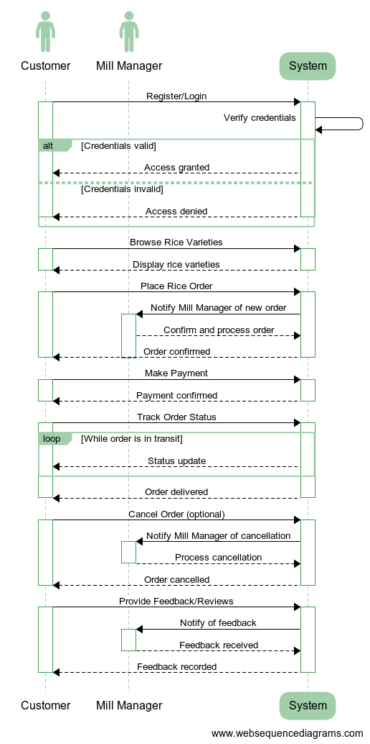
Sequence Diagram 1
This sequence diagram illustrates the interactions between a Customer, a Mill Manager, and the System as the Customer order his rice. The diagram captures the flow of messages exchanged during the selling process.
Notes:
Sequence Diagram in Object-Oriented Analysis and Design (OOAD)
Definition:
A sequence diagram is a type of interaction diagram that shows how objects interact in a particular scenario of a use case, emphasizing the order of messages exchanged between those objects over time. It provides a visual representation of the dynamic behavior of the system, illustrating the sequence of events that occur during a specific process.
Components of a Sequence Diagram:
1. Actors: Represent external entities (users or other systems) that interact with the system. They are depicted as stick figures or labeled boxes at the top of the diagram.
2. Objects: Represent instances of classes that participate in the interaction. They are depicted as labeled rectangles (lifelines) that extend vertically.
3. Lifelines: A vertical dashed line that represents the existence of an object over time. It shows when an object is created and when it ceases to exist.
4. Messages: Arrows between lifelines indicate the communication between objects. The arrows can represent different types of messages:
• Synchronous Messages: Indicate a call to a method, where the sender waits for a response.
• Asynchronous Messages: Indicate a call to a method, where the sender does not wait for a response.
• Return Messages: Indicate the return of control and data from a method.
5. Activation Boxes: Rectangles on the lifelines that show when an object is active or processing a message.
Why Use Sequence Diagrams?
1. Visualizing Interactions: Sequence diagrams provide a clear visualization of how different objects interact in a specific scenario, making it easier to understand the flow of messages.
2. Clarifying Use Cases: They help clarify complex use cases by breaking down the interactions into manageable sequences of events, providing insight into how a particular functionality is implemented.
3. Identifying Object Responsibilities: Sequence diagrams help identify the responsibilities of each object in a process, aiding in the design of class interfaces and collaboration.
4. Communication Tool: They serve as effective communication tools among team members, stakeholders, and developers, helping everyone understand the system’s dynamic behavior.
5. Support for Testing and Debugging: By visualizing the sequence of events, sequence diagrams can assist in testing and debugging by providing a clear reference for expected interactions.
6. Documentation: Sequence diagrams serve as part of the system documentation, helping future developers understand the design and implementation of specific features.
Example of a Sequence Diagram
Here’s a simple example of a sequence diagram for a Customer Placing an Order in the Online Rice Mill Management System:
+----------------+ +-----------------+ +-----------------+
| Customer | | OrderSystem | | Database |
+----------------+ +-----------------+ +-----------------+
| | |
| Place Order() | |
|-------------------------->| |
| | Validate Order() |
| |-------------------------->|
| | |
| | Save Order() |
| |-------------------------->|
| | |
| | Confirm Order() |
| |<--------------------------|
| | |
| Order Confirmation | |
|<--------------------------| |
| | |
Explanation:
• Actors and Objects: In this diagram, the Customer is the actor interacting with the OrderSystem (the system under consideration) and the Database (external system).
• Messages: The arrows indicate messages exchanged:
• The customer places an order, which the system validates.
• The order is saved in the database, and the system confirms the order back to the customer.
• Flow of Control: The sequence of arrows represents the order of operations, showing how the system processes the customer’s request.
Conclusion
Sequence diagrams are a vital part of OOAD, enabling the visualization of object interactions within specific scenarios. They help in understanding dynamic behavior, clarifying use cases, identifying responsibilities, and facilitating communication and documentation throughout the development process.

Slide 10
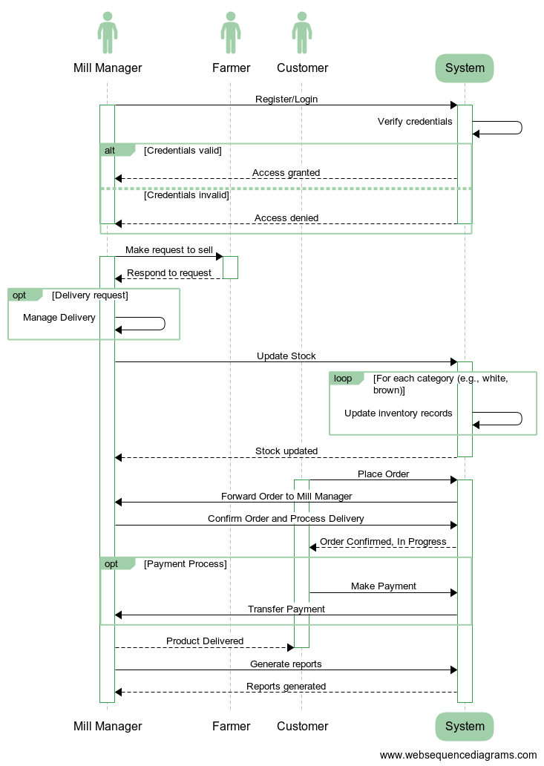
Sequence Diagram 2
This sequence diagram illustrates the interactions between a Mill Manager, Farmers, Customers, and the System during the processes of selling rice to customers and buying paddy from farmers. The diagram captures the flow of messages exchanged throughout these transactions.
Notes:
Sequence Diagram: Mill Manager Interacting with Farmers and Customers to Sell Rice and Buy Paddy
This sequence diagram illustrates the interactions between a Mill Manager, Farmers, Customers, and the System during the processes of selling rice to customers and buying paddy from farmers. The diagram captures the flow of messages exchanged throughout these transactions.
Components:
• Mill Manager: The individual responsible for purchasing paddy from farmers and selling rice to customers.
• Farmers: The individuals selling paddy to the mill manager.
• Customers: The buyers looking to purchase rice.
• System: The digital platform facilitating all transactions.
Sequence of Interactions:
1. Mill Manager Buys Paddy from Farmers:
1. Browse Available Paddy:
• The mill manager accesses the system to view listings of paddy available for sale by farmers.
2. Selects Farmer’s Paddy:
• The mill manager selects a specific farmer’s paddy and sends a purchase request to the system.
3. System Notifies Farmer:
• The system notifies the farmer of the mill manager’s purchase request, providing details for review.
4. Farmer Accepts or Negotiates:
• The farmer reviews the request and can accept the terms or negotiate through the system.
5. Order Confirmation:
• Once the farmer accepts the terms, the system processes the order confirmation and updates both parties.
6. Farmer Delivers Paddy:
• The farmer delivers the paddy to the mill, as agreed in the order confirmation.
7. Quality Inspection:
• The mill manager inspects the paddy quality upon delivery and confirms acceptance through the system.
8. System Records Transaction:
• The system records the transaction, updating the inventory and notifying both the mill manager and farmer.
2. Mill Manager Sells Rice to Customers:
1. View Rice Inventory:
• The mill manager accesses the system to check the available rice inventory.
2. Customer Places Order:
• The customer browses the rice listings and places an order through the system.
3. System Notifies Mill Manager:
• The system notifies the mill manager of the customer’s order details for processing.
4. Confirm Order:
• The mill manager reviews the order and confirms it in the system.
5. Prepare for Delivery:
• The mill manager prepares the ordered rice for delivery and updates the order status.
6. Notify Customer:
• The system notifies the customer of the order status and estimated delivery time.
7. Delivery of Rice:
• The rice is delivered to the customer.
8. Customer Confirms Receipt:
• The customer confirms receipt of the rice in the system.
9. System Records Sale:
• The system records the sale transaction and updates inventory accordingly.
Visual Representation:
+-----------------+ +-----------------+ +-----------+ +-----------------+
| Mill Manager | | System | | Farmer | | Customer |
+-----------------+ +-----------------+ +-----------+ +-----------------+
| | | |
| Browse Available Paddy | | |
|--------------------------->| | |
| | Display Paddy Listings | |
| |---------------------------->| |
| | | |
| Select Farmer's Paddy | | |
|--------------------------->| | |
| | Send Purchase Request | |
| |---------------------------->| |
| | | |
| Notify Farmer of Request | | |
|<---------------------------| | |
| | | |
| Accept/Negotiate Terms | | |
|--------------------------->| | |
| | Process Order Confirmation | |
| |---------------------------->| |
| | | |
| Farmer Delivers Paddy| | |
|--------------------------->| | |
| | | |
| Quality Inspection | | |
|--------------------------->| | |
| | | |
| Record Transaction | | |
|<---------------------------| | |
| | | |
| | | |
| View Rice Inventory | | |
|--------------------------->| | |
| | Display Rice Inventory | |
| |---------------------------->| |
| | | |
| Customer Places Order | | |
| | | |
| | Notify Mill Manager | |
|<---------------------------| | |
| | | |
| Confirm Order | | |
|--------------------------->| | |
| | Prepare for Delivery | |
| |---------------------------->| |
| | | |
| Notify Customer | | |
|--------------------------->| | |
| | | |
| Delivery of Rice | | |
|--------------------------->| | |
| | | |
| Confirm Receipt | | |
|<---------------------------| | |
| | | |
| Record Sale | | |
|<---------------------------| | |
| | | |
Conclusion:
This sequence diagram provides a clear visualization of the interactions between the mill manager, farmers, customers, and the system during the processes of buying paddy and selling rice. It highlights the key steps involved in each transaction, ensuring a smooth and efficient operation for all parties.

Slide 11
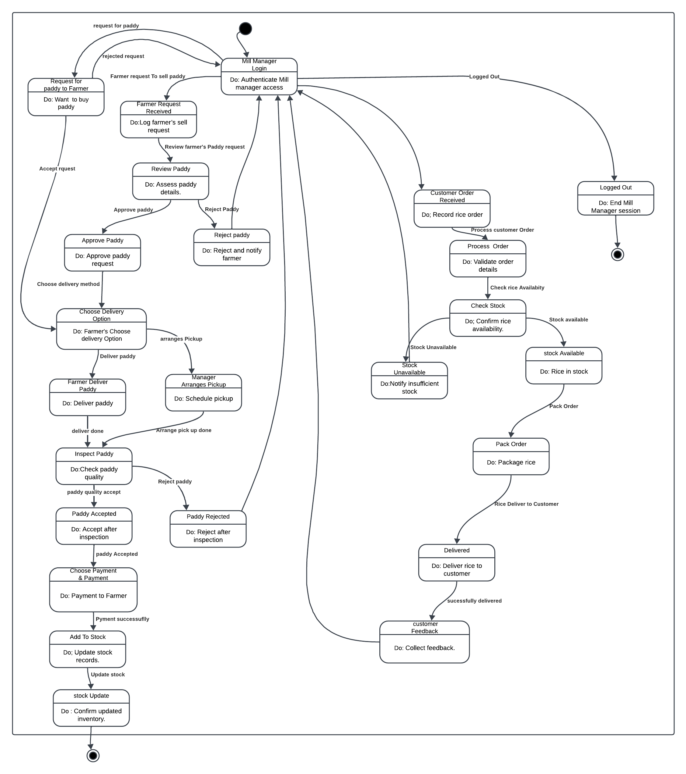
State Chart Diagram
This State Chart Diagram for Mill Managers illustrates the various states in which a mill manager can be during the paddy purchasing and rice selling processes. Key states include request for selling paddy to farmer, selling rice to customer, Inspecting Delivery, Confirming Payment, and Complete Negotiation, Delivery Received, and Payment Processed, providing a clear view of the mill manager’s workflow.
Notes:
A State Chart Diagram (or State Diagram) is a type of diagram in Object-Oriented Analysis and Design (OOAD) that models the dynamic behavior of an object over its lifetime. It represents the different states an object can be in and how it transitions between these states in response to events or conditions.
Key Features:
• States: Represents the various conditions or situations in which an object may exist.
• Transitions: Arrows showing how an object moves from one state to another, usually triggered by events.
• Events: Actions or occurrences that can cause a transition between states.
• Actions: Activities that occur as a result of a transition.
Purpose of State Chart Diagrams:
1. Modeling Behavior: Helps in understanding the lifecycle of an object, detailing how it reacts to various events.
2. Visualizing Complex Logic: Makes it easier to visualize complex state-dependent behavior and transitions.
3. Clarifying Requirements: Aids in clarifying requirements by showing how an object should behave in different scenarios.
4. Identifying States and Events: Helps in identifying the key states and events necessary for an object’s functionality, which can inform design decisions.
5. Improving Communication: Serves as a communication tool among stakeholders, such as developers, designers, and clients, to ensure everyone has a shared understanding of the system behavior.
Example Use Cases:
• Modeling the states of an order in an e-commerce system (e.g., “Pending,” “Shipped,” “Delivered”).
• Describing the various states of a traffic light system (e.g., “Red,” “Green,” “Yellow”).
• Representing user authentication processes (e.g., “Logged Out,” “Logged In,” “Locked Out”).
In summary, state chart diagrams are crucial in OOAD for illustrating how an object behaves in response to different events, which enhances understanding and communication in the design and development process.

Slide 12
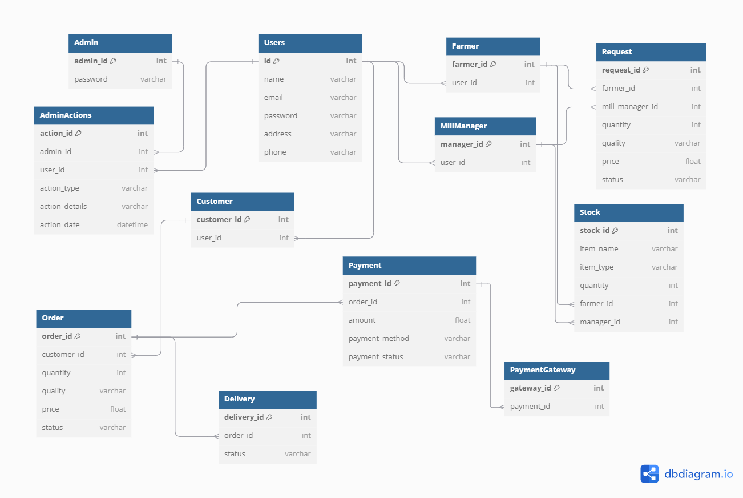
Database Schema
Notes:
Database Schema in Object-Oriented Analysis and Design (OOAD)
Definition:
A database schema is the organizational blueprint of a database that defines its structure, including the tables, fields, data types, relationships, constraints, and indexes. It specifies how data is organized and how different entities within the database interact with each other.
Why Use a Database Schema in OOAD:
1. Data Organization: A schema helps organize data efficiently, ensuring that it is stored in a structured manner for easy retrieval and manipulation.
2. Consistency and Integrity: It establishes rules and constraints that maintain data integrity and consistency, preventing invalid data entries and ensuring that relationships between entities are preserved.
3. Improved Communication: A well-defined schema serves as a communication tool among developers, database administrators, and stakeholders, providing a clear understanding of how data is structured and accessed.
4. Facilitate Design: It aids in the design of the overall system by mapping out how objects in the application relate to database tables, enhancing the alignment between the application and its underlying data.
5. Support for Data Retrieval: A schema defines how queries can be constructed to retrieve data efficiently, supporting the implementation of features in the application.
6. Documentation: The schema serves as documentation for the database structure, making it easier for future developers to understand and maintain the system.
Conclusion:
In OOAD, a database schema is crucial for ensuring efficient data management, integrity, and communication within the development team, ultimately supporting the design and functionality of the system.
Sequence Diagram: Farmer Interacting with Mill Manager and System to Sell Paddy
This sequence diagram illustrates the interactions between a Farmer, a Mill Manager, and the System as the farmer sells their paddy. The diagram captures the flow of messages exchanged during the selling process.
Components:
• Farmer: The individual selling paddy.
• Mill Manager: The person responsible for purchasing paddy from farmers.
• System: The digital platform facilitating the transaction.
Sequence of Interactions:
1. Farmer Lists Paddy for Sale:
• The farmer initiates the process by submitting details of the harvested paddy (quantity, quality, and price) to the system.
2. System Displays Paddy Listing:
• The system confirms the listing and makes the paddy available for mill managers to view.
3. Mill Manager Browses Available Paddy:
• The mill manager accesses the system to browse through the available paddy listings, including the farmer’s paddy.
4. Mill Manager Sends Purchase Request:
• The mill manager selects the farmer’s paddy and sends a purchase request to the system.
5. System Notifies Farmer:
• The system notifies the farmer of the mill manager’s purchase request, providing details for review.
6. Farmer Accepts or Negotiates Terms:
• The farmer reviews the request and can either accept the terms or negotiate through the system’s messaging feature.
7. System Processes Order Confirmation:
• Once the farmer accepts the terms, the system processes the order confirmation and updates both the farmer and mill manager.
8. Farmer Delivers Paddy:
• The farmer delivers the paddy to the mill, as agreed upon in the order confirmation.
9. Mill Manager Confirms Quality:
• Upon delivery, the mill manager inspects the paddy quality and confirms acceptance through the system.
10. System Records Transaction:
• The system records the transaction, updating the inventory and notifying both parties of the successful sale.
Visual Representation:
+-----------+ +-----------------+ +-----------------+
| Farmer | | System | | Mill Manager |
+-----------+ +-----------------+ +-----------------+
| | |
| List Paddy for Sale() | |
|-------------------------->| |
| | Display Paddy Listings |
| |--------------------------->|
| | |
| | Browse Available Paddy |
| | |
| |<---------------------------|
| | |
| | Send Purchase Request |
| |--------------------------->|
| | |
| Notify Farmer of Request | |
|<--------------------------| |
| | |
| Accept/Negotiate Terms | |
|--------------------------->| |
| | Process Order Confirmation |
| |--------------------------->|
| | |
| Deliver Paddy | |
|--------------------------->| |
| | |
| | Confirm Quality |
| |--------------------------->|
| | |
| Record Transaction | |
|<--------------------------| |
| | |
Conclusion:
This sequence diagram provides a clear visualization of the interaction between the farmer, mill manager, and the system during the process of selling paddy. It highlights each step involved, ensuring a smooth and efficient transaction for both parties.

Slide 13
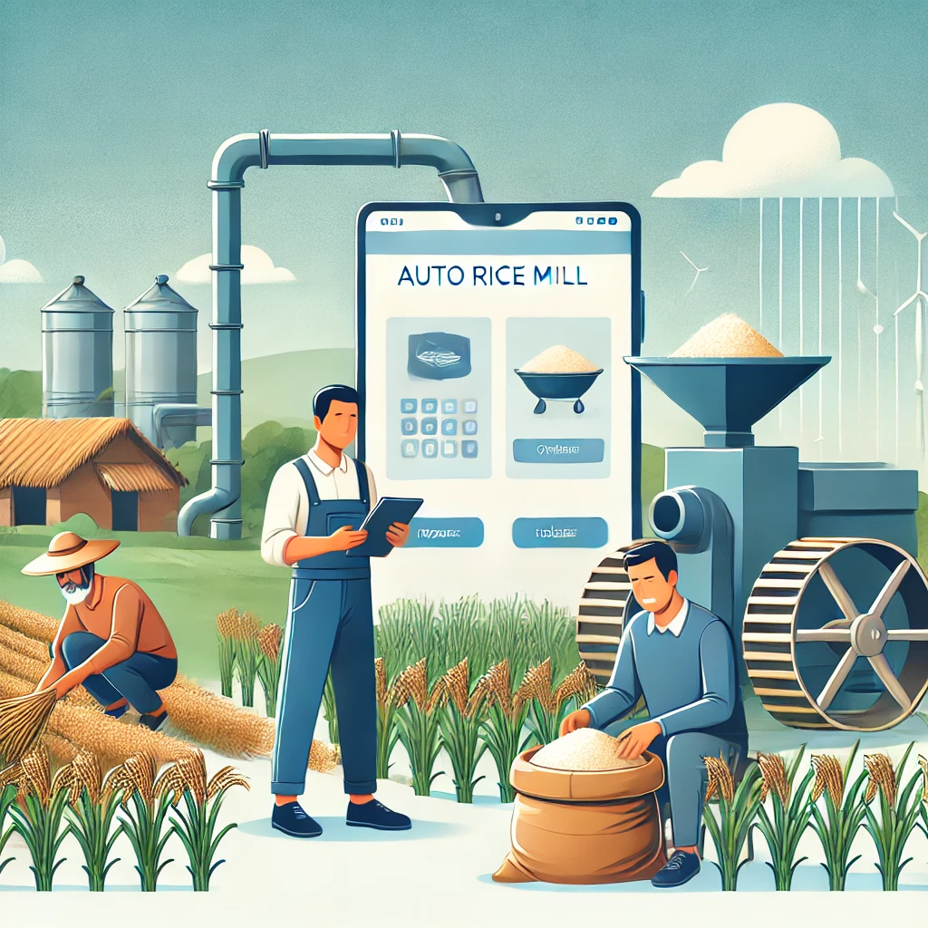
Conclusion
In conclusion, the Auto Rice Mill Management System transforms how farmers, mill managers, and customers interact in the rice supply chain. By connecting everyone on one easy platform, it simplifies selling and buying rice. Farmers can quickly list their products, while customers enjoy a hassle-free online shopping experience. With real-time updates and better inventory management, this system creates a smoother process for all involved, making it easier to ensure quality rice reaches customers while supporting local farmers.

Slide 14
Thank You for being with us

